Slide 1
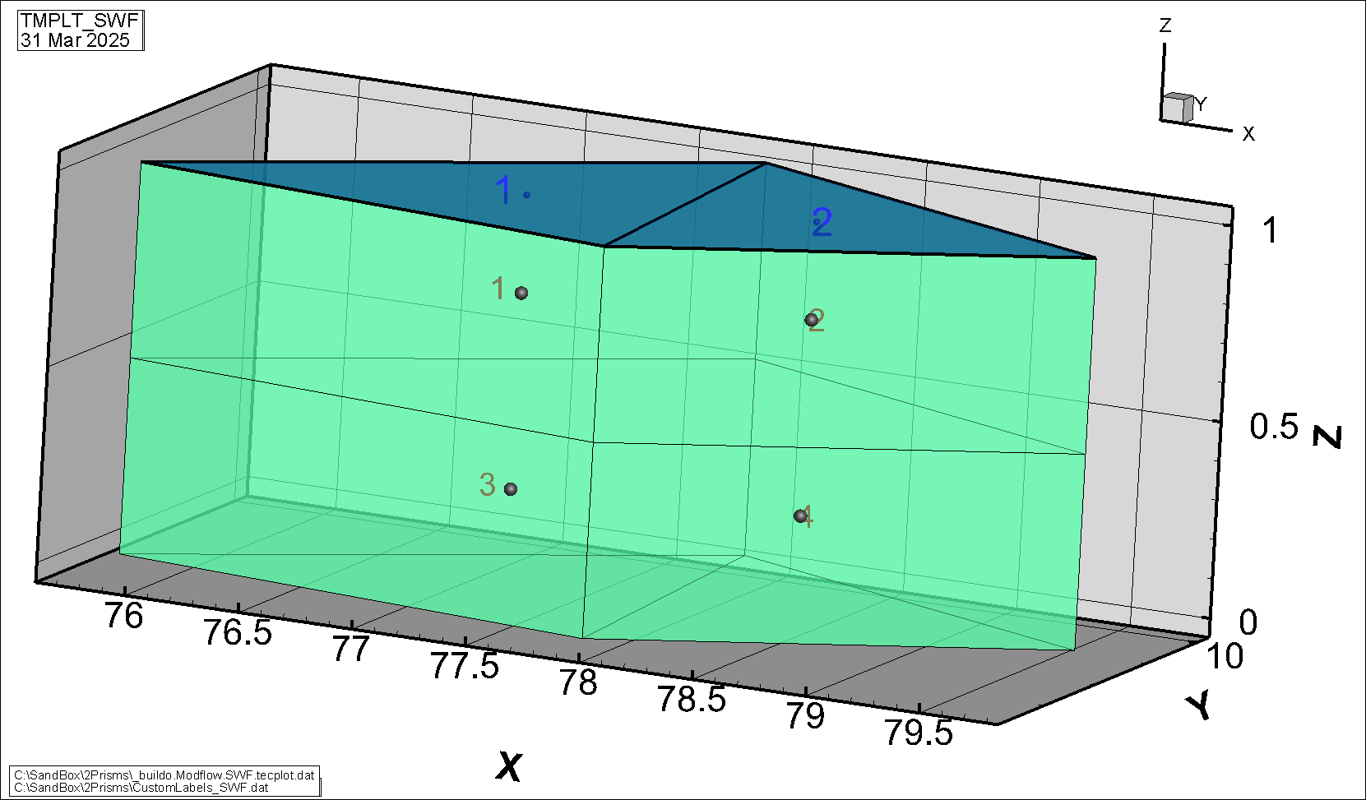
Test Problem 1 Triangular Elements
Mesh-Centred Control Volume
SWF domain:
2 triangular elements (blue shading) at elevation 1 m.
Two SWF modflow cells are created at the element centroid (small blue spheres), one per trianglular element.
GWF domain:
4 6-node prism elements (green shading) in 2 layers with a constant thickness of 0.5 m and a base at elevation 0 m.

Slide 2


Slide 3
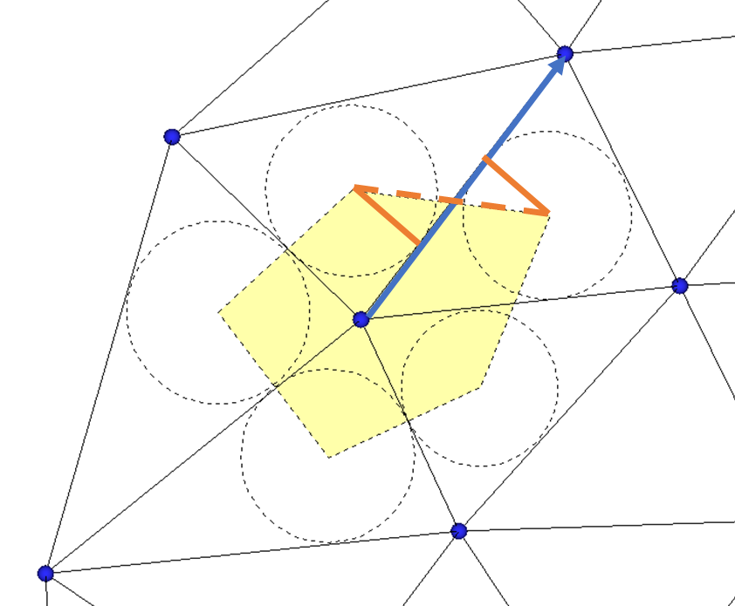
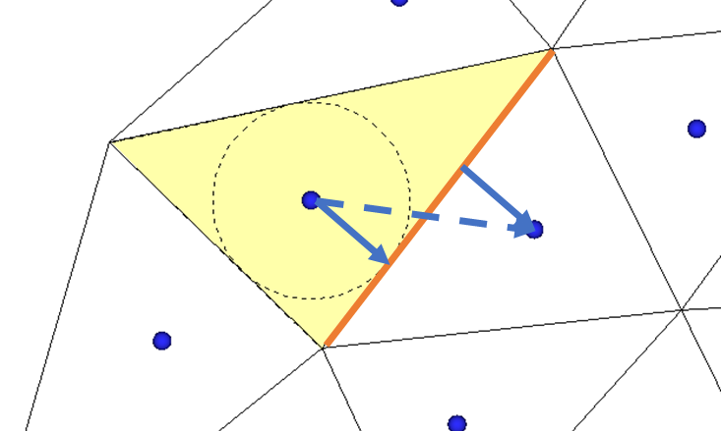
Modflow Cell Control Volumes
Mesh-centred Approach
One Modflow cell is created for each mesh element
Cell connection distance defined by sum of distance from circle centre to edge tangents (blue arrows) or distance between adjacent circle centres (dashed blue arrow)
Cell connection length (orange line) defined by triangular element side length
Node-centred Approach
One Modflow cell is created for each mesh node
Cell connection distance (blue arrow) defined by triangular element side length
Cell connection length defined by sum of distance from circle centre to edge tangents (orange lines) or distance between adjacent circle centres (dashed orange line)

Slide 4
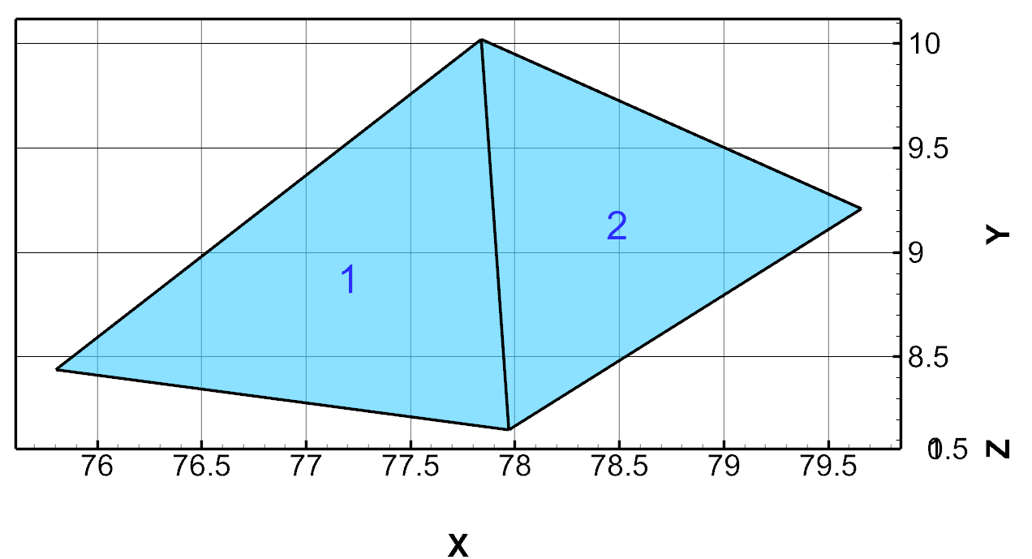
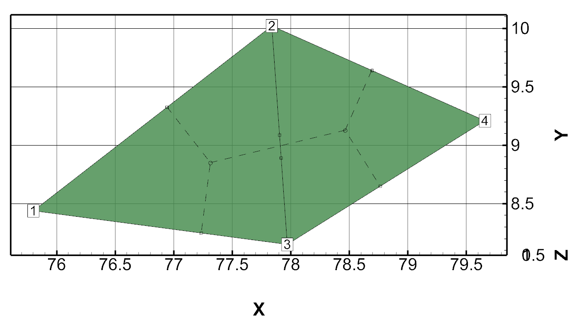
Triangular Mesh
Mesh-centred control volume
Node-centred control volume
Two Modflow cell are created, one per mesh trianglular element.
Cell centers are located approximately at the element centroid, shown by the numbers 1 and 2.
Horizontal cell areas are equal to triangle areas.
Four Modflow cells are created, one per mesh node.
Cell centers are located at nodes, shown by the numbers 1 to 4 .
Horizontal cell areas are defined by the dashed lines.

Slide 5
Modflow.swf file: IA JA Structure
Mesh-centred control volume
Node-centred control volume
INTERNAL 1 (FREE) -1 IA()
2 2
INTERNAL 1 (FREE) -1 JA()
1 2
2 1
INTERNAL 1 (FREE) -1 IA()
3 4 4 3
INTERNAL 1 (FREE) -1 JA()
1 2 3
2 1 3 4
3 1 2 4
4 2 3
The four cells have 3 or 4 connections, depending on whether they appear in only 1 or both elements.
The two cells each have 2 connections.
Cell 1 is connected to itself and cell 2
Cell 1 is connected to itself and cells 2 and 3.

Slide 6
Modflow.swf file: A JA Structure
Mesh-centred control volume
Node-centred control volume
# IFNO IFTYP FAREA FELEV ISSWADI
1 1 2.00694598461 1.00000000000 0
2 1 1.64711341766 1.00000000000 0
# IFNO IFTYP FAREA FELEV ISSWADI
1 1 0.873511468869 1.00000000000 0
2 1 1.21210998050 1.00000000000 0
3 1 0.975424901105 1.00000000000 0
4 1 0.593013051796 1.00000000000 0
FAREA (stored in the array Modflow.SWF.Cellarea) is defined by the TMPLT.ElementArea.
FAREA is defined by the contributing areas outlined by the dashed lines.

Slide 7
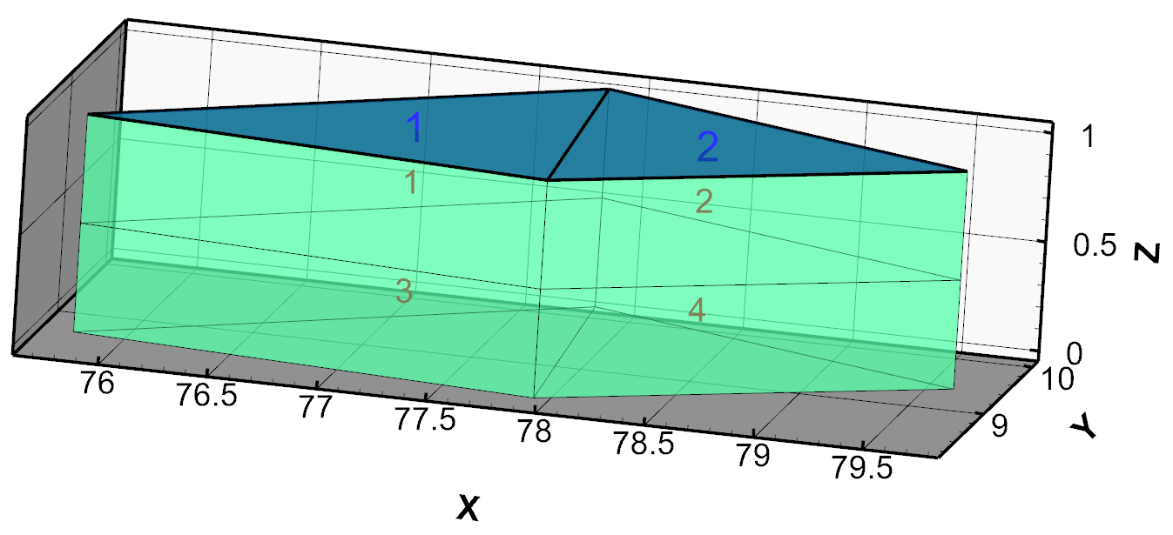
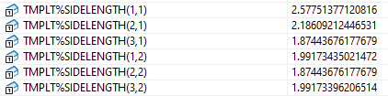
SWF
GWF
INTERNAL 1 (FREE) -1 JA()
1 2
2 1
# IFNO IFTYP FAREA FELEV ISSWADI
1 1 2.0069 1.0000 0
2 1 1.6471 1.0000 0
# IFNO IFGWNO IFCON SGCL SGCAREA ISGWADI
1 1 1 1.00000E-03 2.0069 0
2 2 1 1.00000E-03 1.6471 0
# ISWFTYP SMANN SWFH1 SWFH2
1 5.36112E-02 1.00000E-06 1.00000E-06
2 -999.00 -999.00 -999.00
INTERNAL 1 (FREE) -1 Connection Length CLN()
0.000000000000000E+000 0.604680050482966
0.000000000000000E+000 0.562355789940145
INTERNAL 1 (FREE) -1 Perpendicular Area FAHL()
0.000000000000000E+000 1.87443676177679
0.000000000000000E+000 1.87443676177679
INTERNAL 1 (FREE) -1 JA()
1 2 3
2 1 4
3 4 1
4 3 2
INTERNAL 1 (FREE) -1 Connection Length CLN()
0.000000000000000E+000 0.604680050482966 0.250000000000000
0.000000000000000E+000 0.562355789940145 0.250000000000000
0.000000000000000E+000 0.604680050482966 0.250000000000000
0.000000000000000E+000 0.562355789940145 0.250000000000000
INTERNAL 1 (FREE) -1 Perpendicular Area FAHL()
0.000000000000000E+000 0.937218380888393 2.00694598460755
0.000000000000000E+000 0.937218380888393 1.64711341765776
0.000000000000000E+000 0.937218380888393 2.00694598460755
0.000000000000000E+000 0.937218380888393 1.64711341765776

Slide 8
INTERNAL 1.000000e+00 (FREE) -1 Top elevation Layer 1
1.0000 1.0000
INTERNAL 1.000000e+00 (FREE) -1 Top elevation Layer 2
0.50000 0.50000
INTERNAL 1.000000e+00 (FREE) -1 Bottom elevation Layer 1
0.50000 0.50000
INTERNAL 1.000000e+00 (FREE) -1 Bottom elevation Layer 2
0.0000 0.0000
INTERNAL 1.000000e+00 (FREE) -1 Horizontal Area Layer 1
2.0069 1.6471
INTERNAL 1.000000e+00 (FREE) -1 Top elevation Layer 1
1.0000 1.0000 1.0000 1.0000
INTERNAL 1.000000e+00 (FREE) -1 Top elevation Layer 2
0.50000 0.50000 0.50000 0.50000
INTERNAL 1.000000e+00 (FREE) -1 Bottom elevation Layer 1
0.50000 0.50000 0.50000 0.50000
INTERNAL 1.000000e+00 (FREE) -1 Bottom elevation Layer 2
0.0000 0.0000 0.0000 0.0000
INTERNAL 1.000000e+00 (FREE) -1 Horizontal Area Layer 1
0.87351 1.2121 0.97542 0.59301

Slide 9
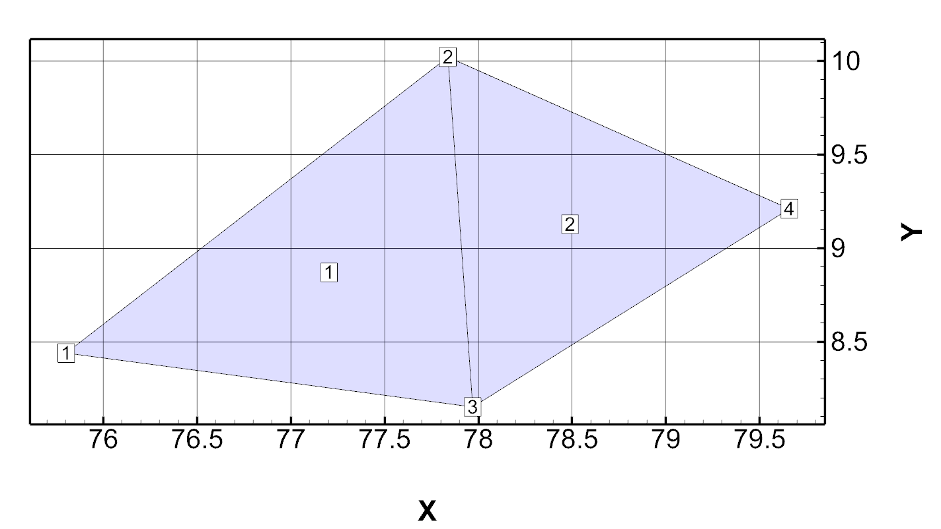
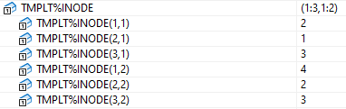
Test Problem 1: 2 triangular elements
This mesh was created by trimming the Grid Builder mesh from the Abdul problem down to 2 elements.
This image was created from the file _buildo.TMPLT.tecplot.dat:
The TMPLT%INODE array shows the node numbers in order around each element e.g. 2, 1, 3 for element 1.

Slide 10
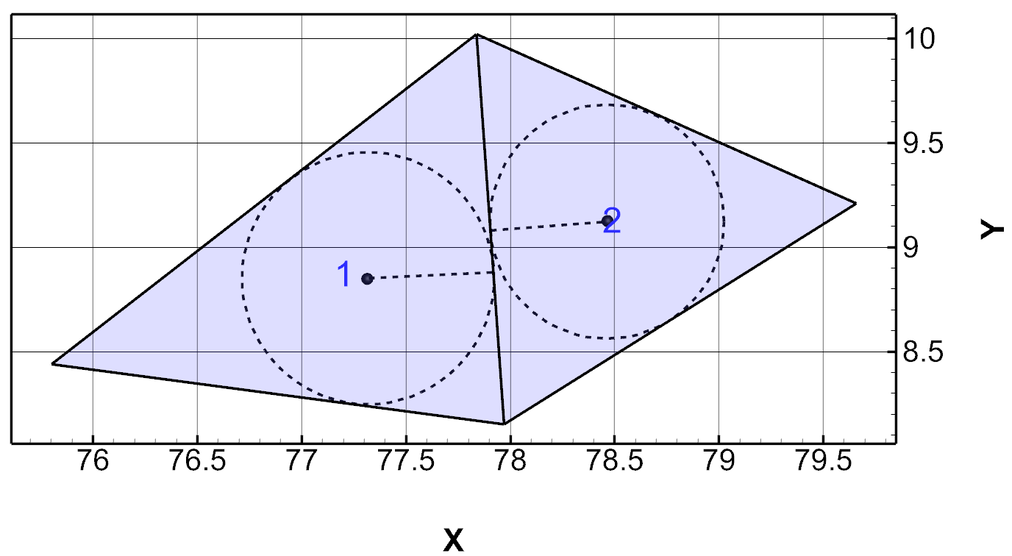
Inner Circles
Inner circles are defined for each mesh triangle as shown by the dashed circles and lines respectively.
The cells are numbered 1 and 2.
The inner circles and circle radii are shown for each triangle.
Inner circle centres are shown by black spheres

Slide 11
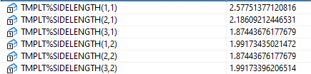
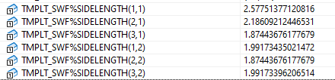

Slide 12
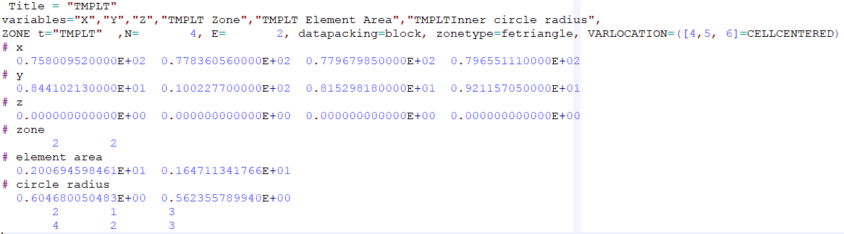
Test Problem 1: 2 triangular elements
Here are the contents of the file _buildo.TMPLT.tecplot.dat:
The original mesh had 2 zones
Element areas are given for triangles 1 and 2
Circle radii are derived from the inner circles of each triangle
The last two lines show the node lists for each triangle

Slide 13
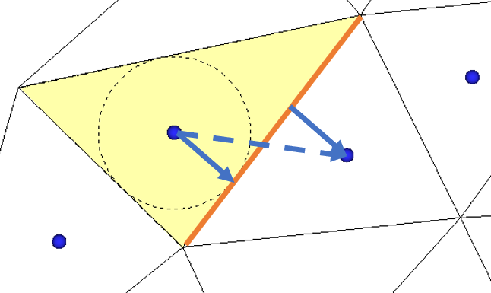
SWF Domain: Mesh-centred control volumes
Mesh-centred Cell-to-cell Connections
Cell connection distance defined by sum of distance from circle centre to edge tangents (blue arrows) or distance between adjacent circle centres (dashed blue arrow)
Cell connection length (orange line) defined by triangular element side length

Slide 14
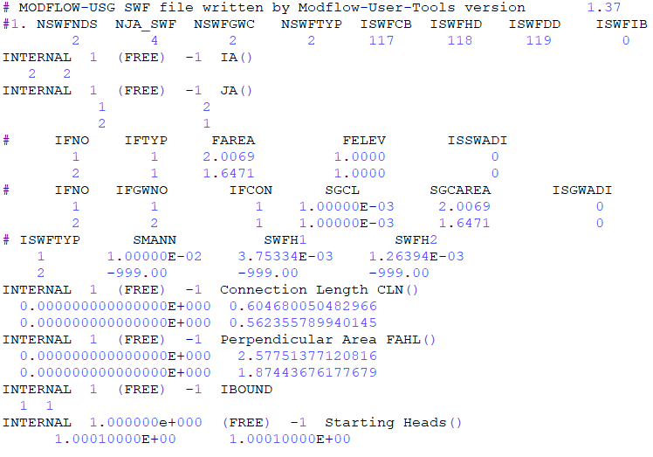
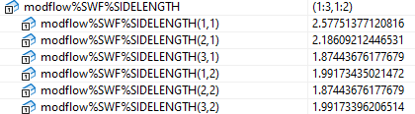
Modflow.swf File

Slide 15
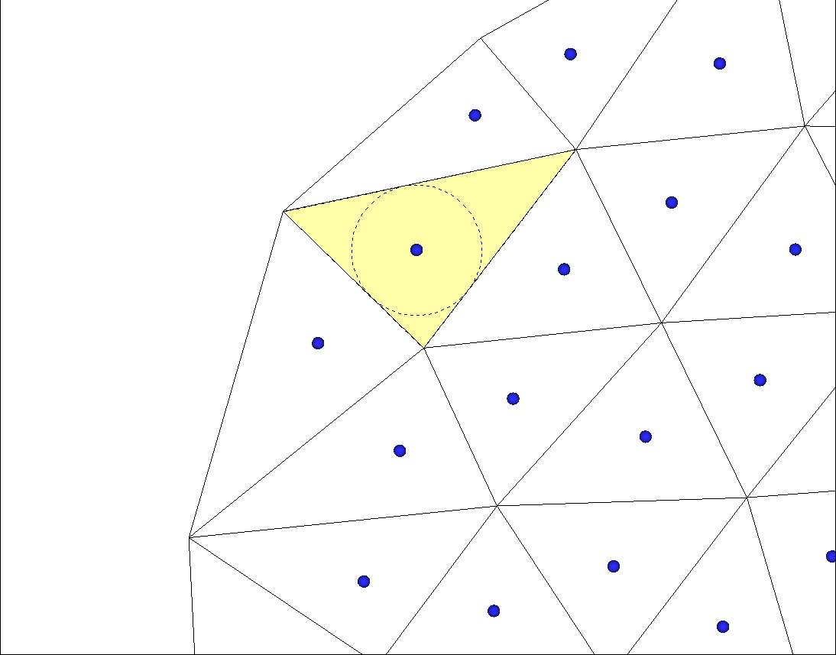
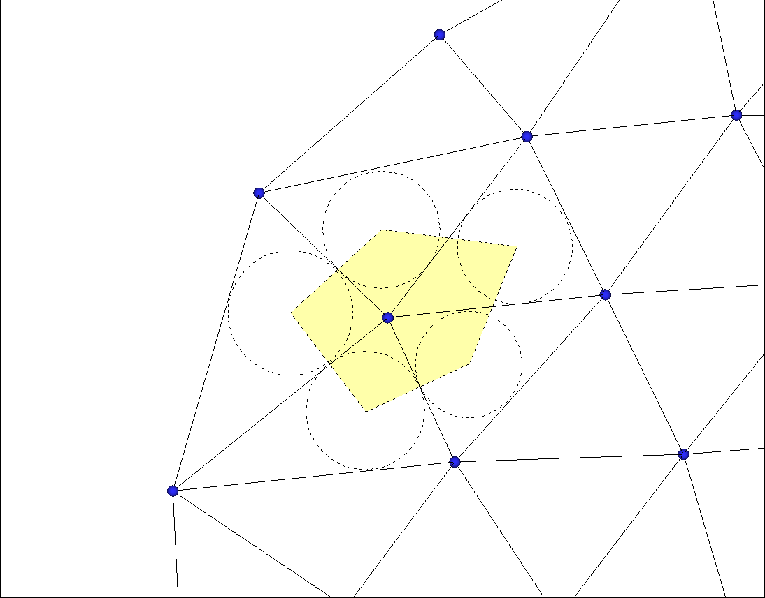

Slide 16
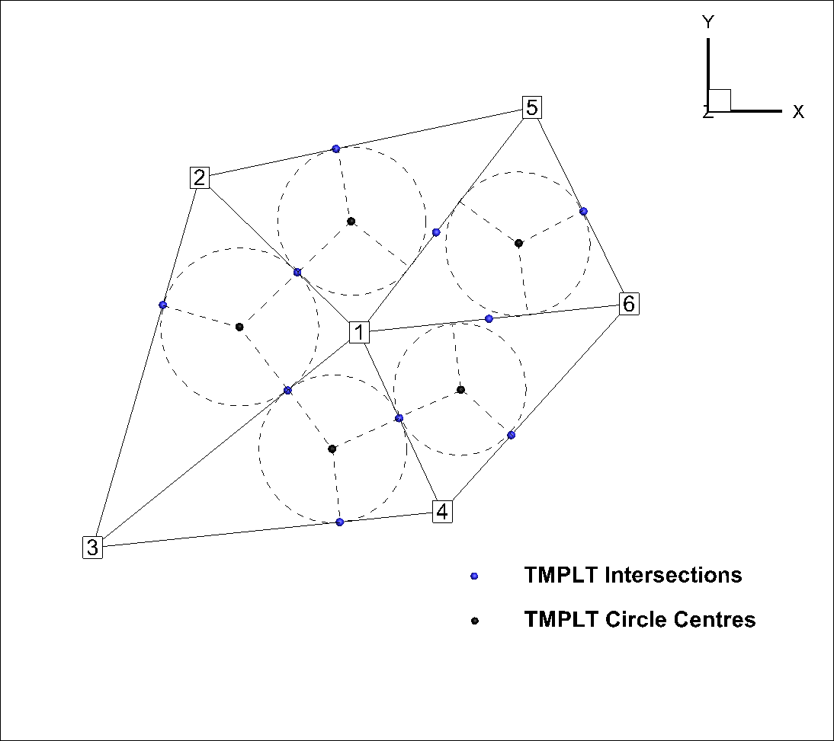
Simple Test Problem: Node-centred Tecplot Generation
Numbers shown to right are Cell numbers
Cell 1 (interior cell):
is connected to cells 2,3,4,5 and 6
horizontal area is defined by the inner circle centres for all elements of which it is a part(blue fill)
flow length to cell 2 is the distance from point 1 to intersection point A
Cell 2 (boundary cell):
is connected to cells 1,3 and 5
horizontal area is defined by the inner circle centres for all elements of which it is a part and tangent points along outer boundary (orange fill)
Cell 2 to Cell 1 flow length is distance from point 2 to intersection point A
Cell 1-2 flow area is distance from point B to point C
C
A
B

Slide 17
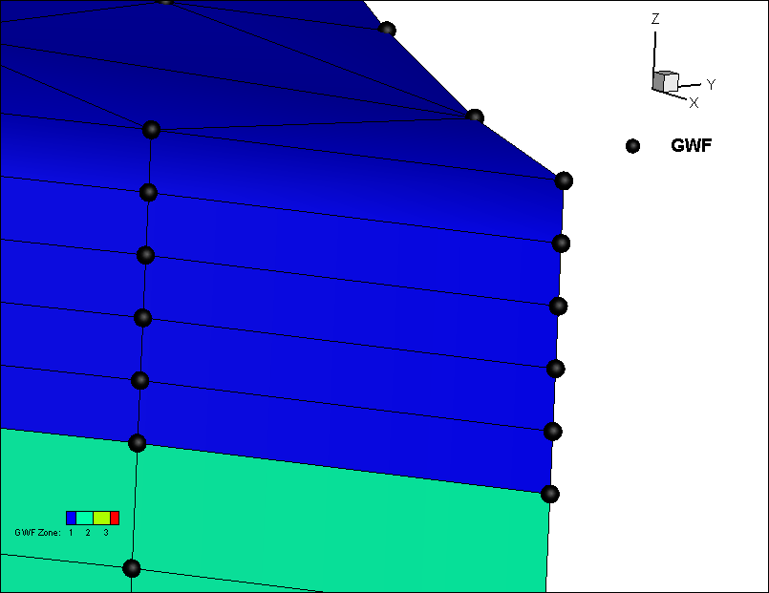
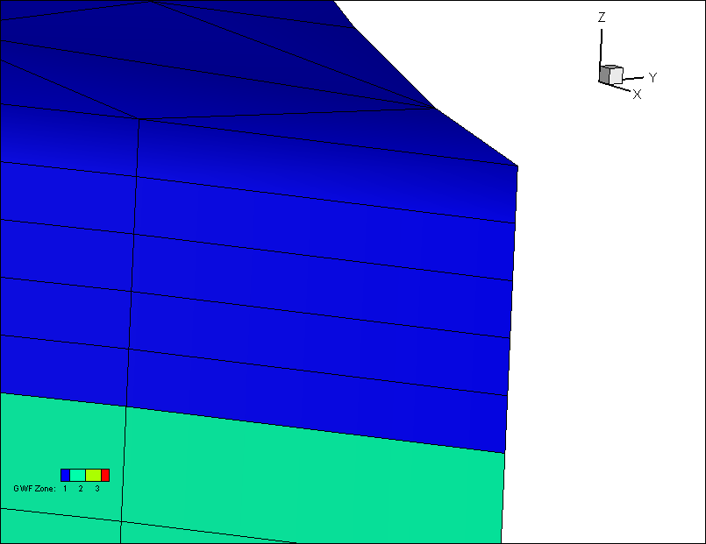
Method 1: half cell at top and bottom of domain
Can be plotted directly in Tecplot because number of cells equals number of nodes
Method 2: full cells
Layer 1
Top
Layer 1
Top
Layer 2
Bottom
Layer 2
Bottom

Slide 18
Node-Centred Modflow Cell Generation Methodology
Define the SWF and GWF domains exactly the same as in the mesh-centred approach. These are used for Tecplot visualization.
We already write the mesh-centred files correctly for Modflow
We just need to swrite a set of node-centred files with the proper IA-JA structure, cell areas, flow lengths and flow areas based on the node-to-node connections define by the node list for each element

Slide 19
Below is the code that writes the Modflow SWF file for the mesh-centred case.
For the node-centred approach, we just have to:
Change all Modflow.SWF.nCells references to Modflow.SWF.nNodes
Define IA and JA appropriately for the node-centred case
!-------------------------------------------------------------
subroutine WriteSWFFiles(Modflow)
implicit none
type (ModflowProject) Modflow
integer :: i, j, i1, i2, nEnd
write(Modflow.iSWF,'(a)') '#1. NSWFNDS NJA_SWF NSWFGWC
write(Modflow.iSWF,'(10i9)') Modflow.SWF.nCells, Modflow.SWF.njag, Modflow.SWF.nCells,…
write(Modflow.iSWF,'(a)') 'INTERNAL 1 (FREE) -1 IA()'
write(Modflow.iSWF,'(10i2)') (modflow.SWF.ia(i),i=1,modflow.SWF.nCells)
write(Modflow.iSWF,'(a)') 'INTERNAL 1 (FREE) -1 JA()'
i1=1
do i=1,modflow.SWF.nCells
i2=i1+modflow.SWF.ia(i)-1
write(Modflow.iSWF,*) (modflow.SWF.ja(j),j=i1,i2)
i1=i2+1
end do

Slide 20
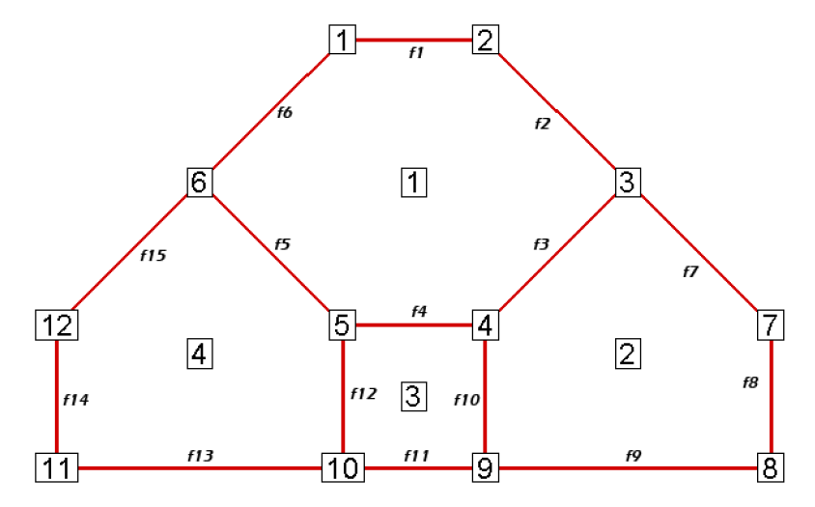
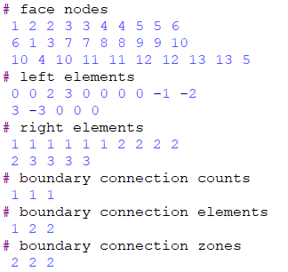
Teplot polygons are face-based, so the connectivity list has to look something like this:
For now, we’ll use simpler cell-based template and SWF meshes to define the node-centred modflow domain.

Slide 21
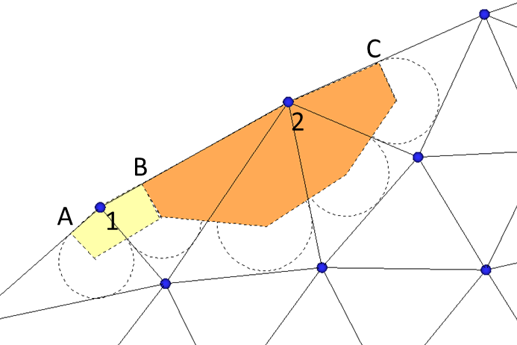
Node-centred Tecplot Representation/Generation
If we define a 2D Tecplot polygon mesh it will give us the neighbour information as before
Tecplot Polygon Element Setup
1 and 2 (original nodes in 2D mesh) define xCell, yCell coordinates
Inner circle centres (a to e) become nodes around the polygon element
New nodes (A to C) must be generated along the outer boundary for each triangular element side
Cell 1 – node list: 1, A, a, b, B
Cell 2 – node list: 2, B, b, c, d, e, C
Inner cell – node list: e.g. a, b, c, d, e, etc depending on number of connections
e
d
b
c
a

Slide 22
Node-centred Tecplot Generation Pseudocode
Flag boundary nodes
Loop over 2D mesh nodes
nCell=nCell+1
xcell(ncell)=x(2D mesh node)
ycell(ncell)=y(2D mesh node)
if(boundary node)
iNode+ = node number
iNode+= A
iNode+= B
endif
loop over elements containing node
iNode+=a
iNode+=b
etc
end loop
End loop
Sort A,B,a,b relative to xcell ycell by angle
e
d
b
c
a

